Slide 1

Product-To-Mount Summary and Mapping
MOUNT-MAP-PRSNT-011 v1.05
Notes:
{slide}

Slide 2
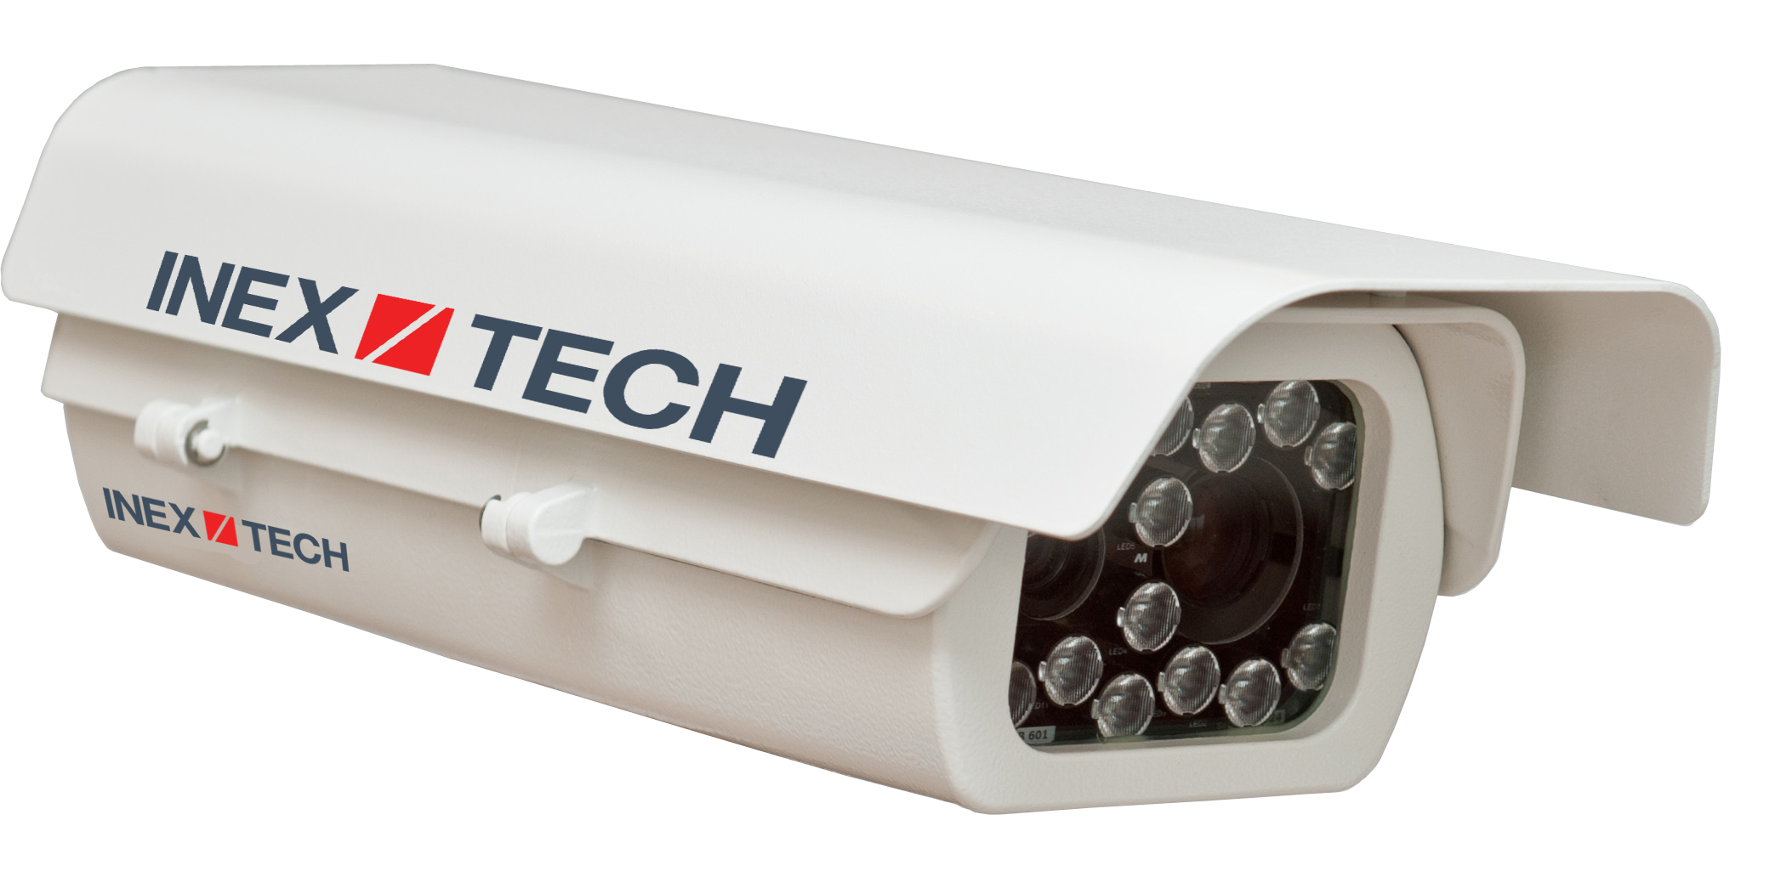
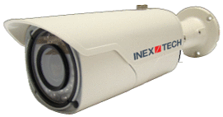

CAMERAS By Market Segment
IZA500Gxx for Parking/Security
IZ600F/FJ for Parking/Security
IZA800Gxxx/IZA800ORT for Tolling
Notes:
{slide}

Slide 3
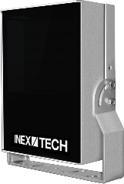
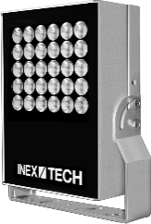
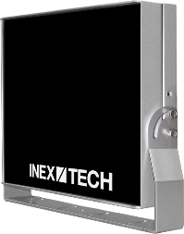
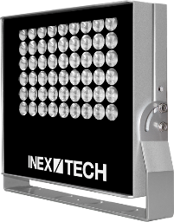
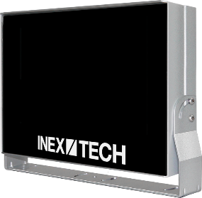
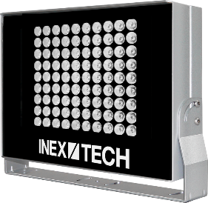
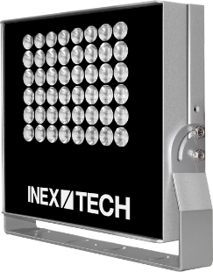

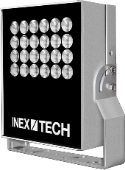
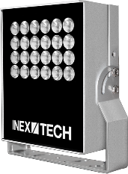
Illuminator Product Types
IZS* Strobe Illuminators
IZL Illuminators
*The IZS designation also includes IZSVES illuminators
Notes:
{slide}

Slide 4
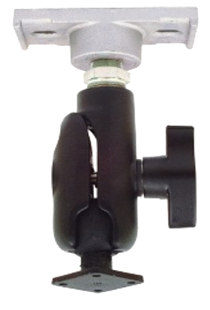
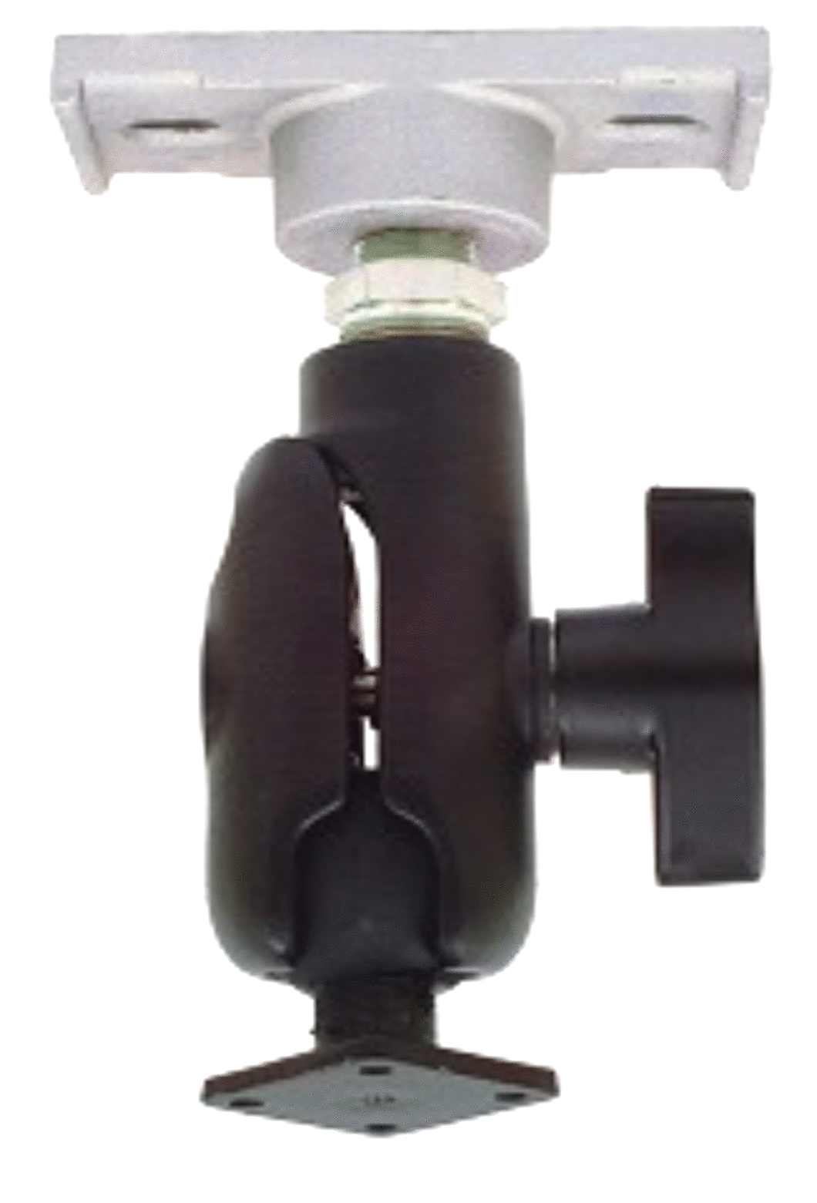
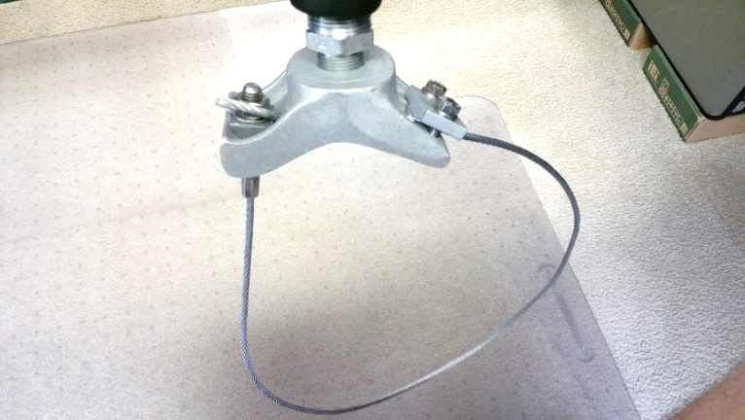
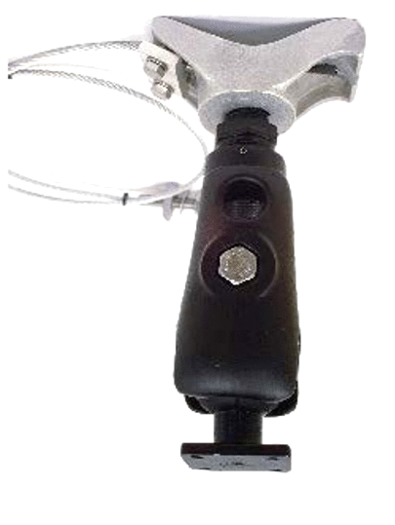
Mounts – GANTRY/Ceiling COMPONENTS
GS – small gantries or ceiling Square or 1.5" - 4" round gantry or ceiling
GL – large gantries 4" - 12" round gantry
Notes:
{slide}

Slide 5
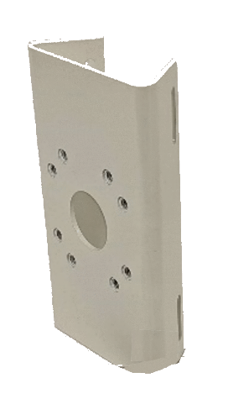
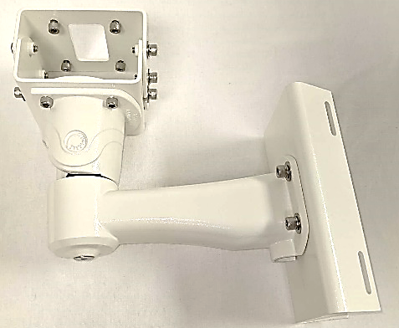
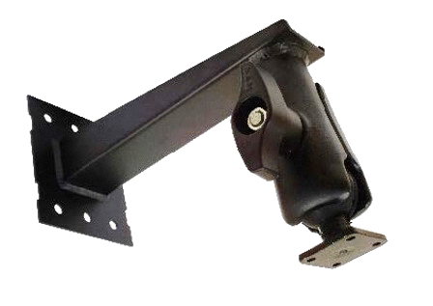
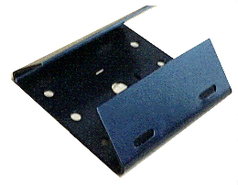
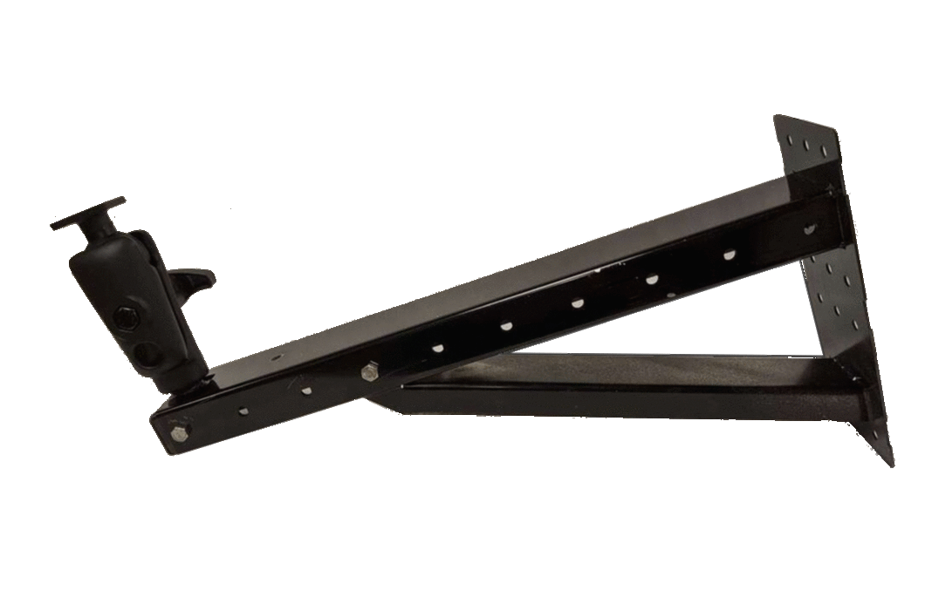
Mounts – MAIN Components
White (3-axis) – W3X-W; can add PMA-W; For IZA500Gxx cameras For 2.5"-6" pole
Heavy Duty (Black) – W3X; plus PMA for 2.5" to 6" pole For IZA800Gxxx/IZA800ORT cameras, and illuminators
Socket on fixed arm (W3X)
Socket on adjustable arm (W3X-A)
Notes:
{slide}

Slide 6
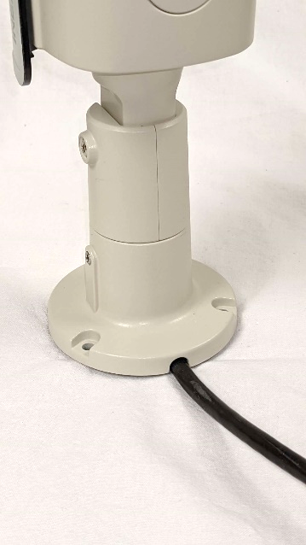
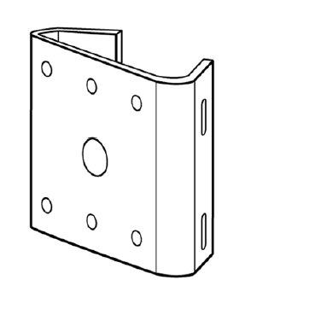
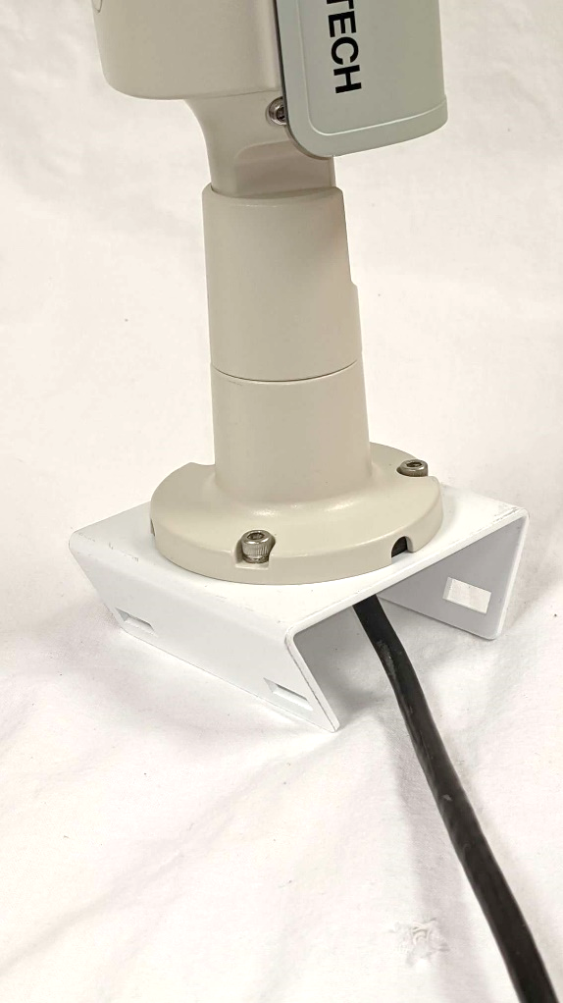
Mounts – IZ600F/FJ COMPONENTS
IZ600F/FJ already comes with a wall mounting bracket built in
PMA-IZ600F – the PMA for the IZ600F/FJ; for 3"-5" pole
Notes:
{slide}

Slide 7
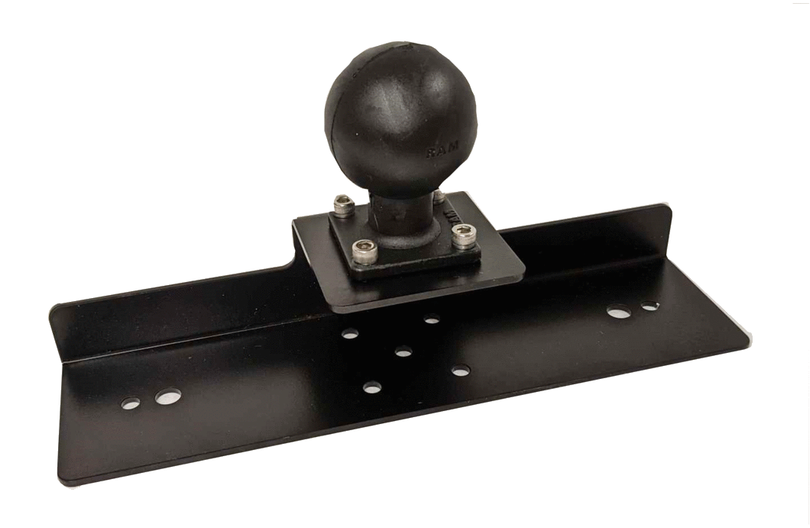
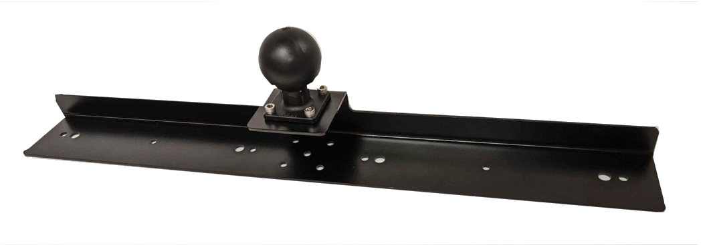
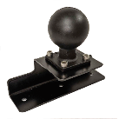
Mounts – UNDERHANG/ADAPTER COMPONENTS
UCAIZ – Underhang Camera Adapter
UIL – Illuminator Adapters
UIL – for one L2/S2*
UIL-2X – for two L2/S2s*
UIL-S – for one L1/S1*
*The IZS designation also includes IZSVES illuminators
Notes:
{slide}

Slide 8

GS/GL Gantry/Ceiling Camera Mounting
IZA800Gxxx/ IZA800ORT*
GS (small gantry or ceiling)
GL (large gantry)
x
IZA800Gxxx/ IZA800ORT*
GS (small gantry)
GL (large gantry)
*IZA500Gxx can be used with W3X mounts, but are typically used with W3X-W
UCAIZ (Underhang Camera Adapter) plus IZA800Gxxx/IZA800ORT camera*
Notes:
{slide}

Slide 9

W3X Wall/Pole Camera Mounting
x
IZA800Gxxx/ IZA800ORT*
W3X
PMA
W3X
PMA
W3X-A
W3X-A
*IZA500Gxx can be used with W3X mounts, but are typically used with W3X-W
UCAIZ (Underhang Camera Adapter) plus IZA800Gxxx/IZA800ORT camera*
Notes:
{slide}

Slide 10
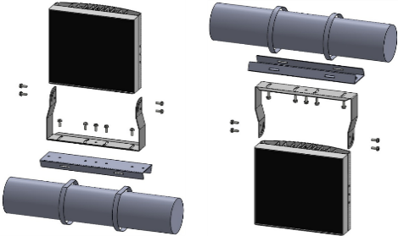
GS/GL UIL Gantry/Ceiling Illuminator Mounting
GS (small gantry or ceiling)
GL (large gantry)
IZS*/IZL Illuminator
x
IZS*/IZL Illuminator
UIL-2X for two L2/S2s UIL for one L2/S2 UIL-S for one L1/S1
UIL-2X for two L2/S2s UIL for one L2/S2 UIL-S for one L1/S1
GS (small gantry)
UIL-2X for two L2/S2s UIL for one L2/S2 UIL-S for one L1/S1
GL (large gantry)
*The IZS designation also includes IZSVES illuminators
UIL (Illuminator Adapter) plus IZL/IZS* illuminator
Notes:
{slide}

Slide 11
W3X Wall/Pole ILLUMINATOR Mounting
PMA
x
IZS*/IZL Illuminator
W3X
UIL-2X for two L2/S2s UIL for one L2/S2 UIL-S for one L1/S1
W3X-A
W3X
PMA
UIL-2X for two L2/S2s UIL for one L2/S2 UIL-S for one L1/S1
W3X-A
UIL (Illuminator Adapter) plus IZL/IZS* illuminator
*The IZS designation also includes IZSVES illuminators
Notes:
{slide}

Slide 12
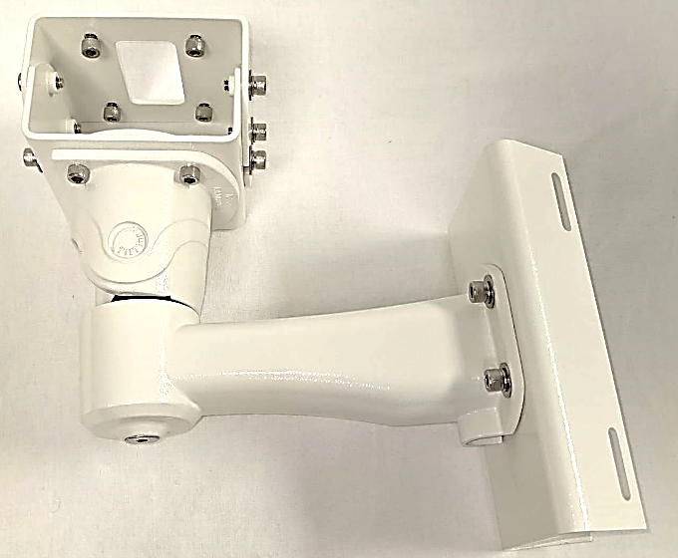
W3X-W Wall/Pole Camera Mounting
x
IZA500Gxx
PMA-W
W3X-W
Notes:
{slide}

Slide 13
Product-to-Mount Mapping/KITS
*IZA500Gxx cameras can be used with W3X mounts, but are typically used with W3X-W
Product Family | Gantry/ Ceiling | Wall/Pole | PMA | Underhang/ Adapter | Part No. Examples (Kits)
IZA500Gxx* for Parking/Security | N/A | W3X-W | PMA-W | N/A | MNT-W3X-PMA-W
IZ600F/FJ for Parking/Security | N/A | Included w/camera | PMA-IZ600F | N/A | MNT-PMA-IZ600F
IZA800Gxxx for Tolling | GS (G/C) GL (G only) | W3X/W3X-A | PMA | UCAIZ | MNT-GS-UCAIZ
IZS1/IZSVES1 Strobe Illuminators | GS (G/C) GL (G only) | W3X/W3X-A | PMA | UIL-S (1 S1) | MNT-GL-UIL-S
IZS2/IZSVES2 Strobe Illuminators | GS (G/C) GL (G only) | W3X/W3X-A | PMA | UIL (1 S2) UIL-2X (2 S2s) | MNT-GS-UIL MNT-W3X-PMA-UIL-2X
IZL1 Illuminators | GS (G/C) GL (G only) | W3X/W3X-A | PMA | UIL-S (1 L1) | MNT-GL-UIL-S
IZL2 Illuminators | GS (G/C) GL (G only) | W3X/W3X-A | PMA | UIL (1 L2) UIL-2X (2 L2s) | MNT-GS-UIL MNT-W3X-PMA-UIL-2X
Notes:
{slide}

Slide 14
Thank You
www.inextechnologies.com
Notes:
{slide}

